Slide 1



A Postgres Server for point clouds storage and processing
Presented at postgresl PARIS session 6.
https://github.com/Remi-C/Postgres_Day_2014_10_RemiC
Rémi Cura
Julien Perret – Nicolas paparoditis – GildaS Le meur
Notes:
This presentation aims at
- introducing point cloud data, a new type of geo-spatial data
- demonstrating that using a point cloud server is better than using file system.
- demonstrating that a point cloud server can be easily made and is efficient
- demonstrating some advanced capabilities of such point cloud server

Slide 2
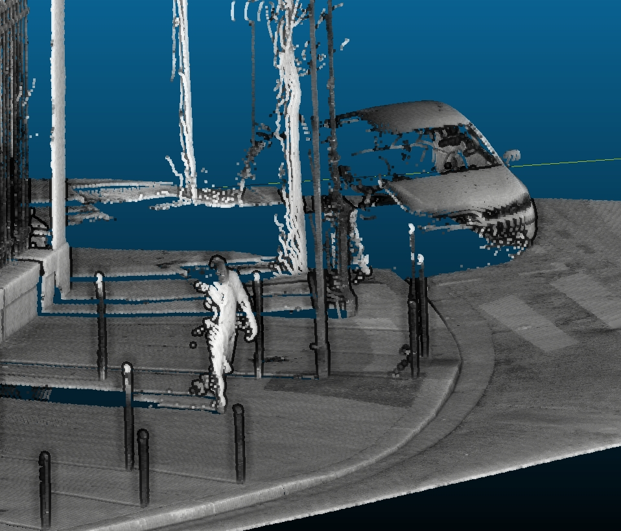
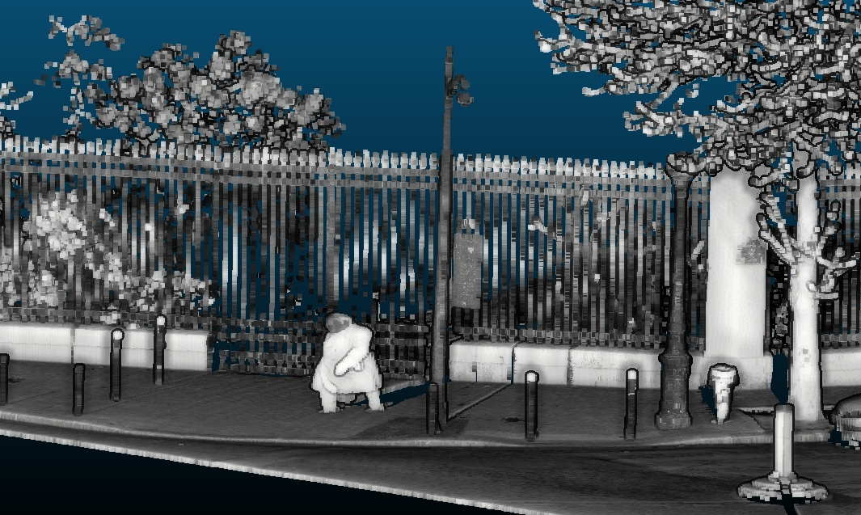
Introduction to Point clouds
New kind of human: point cloud human!
Notes:
Here is an example of a terrestrial high density pointcloud acquired by a vehicle in Paris street. The grey level is proportional to the intensity of the returned laser impulsion

Slide 3
Contents
1. Introduction to Point clouds
2. Why use a DBMS?
3. PointCloud : Efficient storing/QUERYING/LOADING in postgRes
4. In base processing
5. using the point cloud server in complex architectures
A. references
Notes:
We first introduce to Point Cloud data. Then we show that such data is better used inside a DBMS rather than in file system
Storing the data in DBMS allows fast operation, like different type of querying
We can also directly process data in base.
Last, such point cloud server can be integrated into complex architecture with other servers.

Slide 4
Warning
A fair warning :
Except PointCloud extension : research tools.
NOT for production, NOT reliable
All open source (here , here , here), including nice data set
Thanks to my colleagues!
efficient storing/querying/Loading in postgres Prototype
In base processing Proof of concept
Visualization
LOD Proof of concept
Streaming Prototype
Complex architecture
Point cloud streaming Prototype
Interactive road side modeling Prototype
Batch computing Prototype
Notes:
All the work we present is open source.
It showcase advanced usages, that are mostly proof of concept or prototype.
This examples demonstrate that a point cloud server can work and give orders of magnitude, but are absolutely not suited for production usage.
Be careful if you re-use code.

Slide 5
Introduction to Point clouds
What are point clouds
Order of magnitude

Slide 6
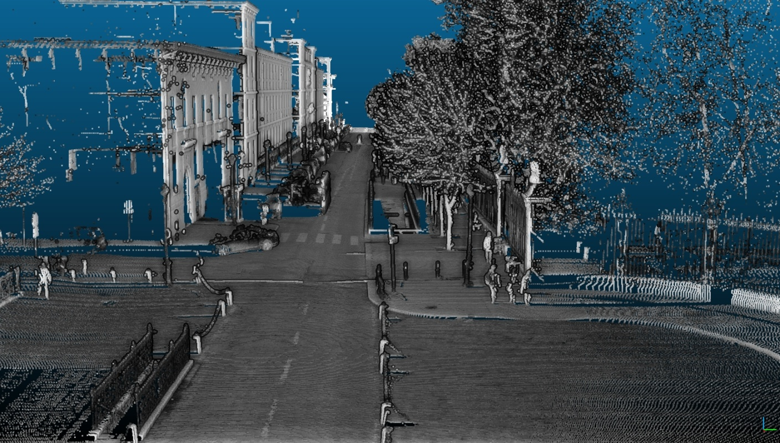
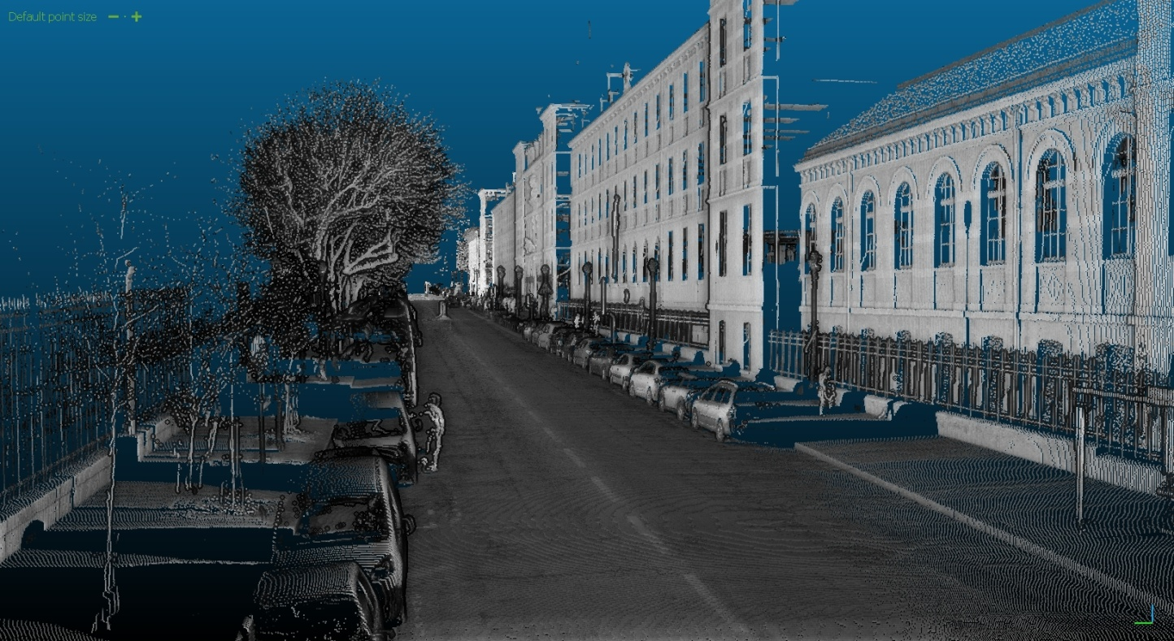
Introduction to Point clouds
Riegl reflectance
Riegl reflectance
Notes:
12 millions points, with the color proportional to intensity of reflected light. Note that the lighting is artificial and only helps to understand the scene.

Slide 7
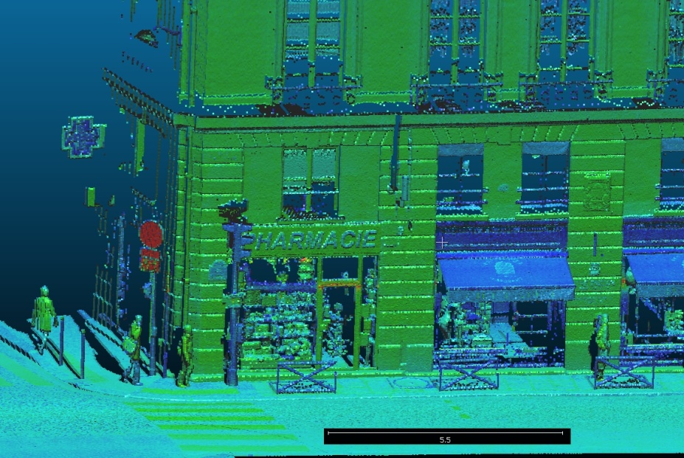
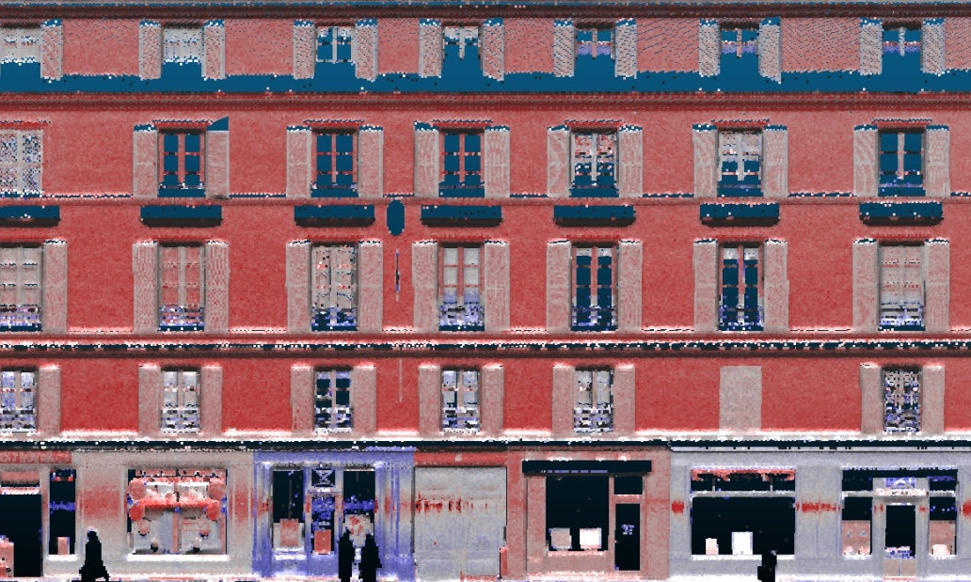
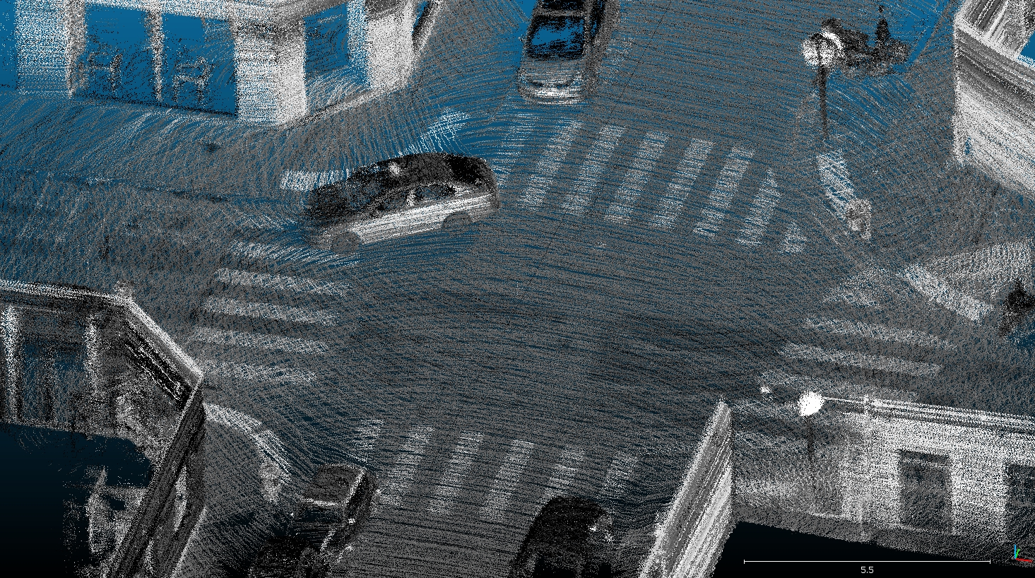
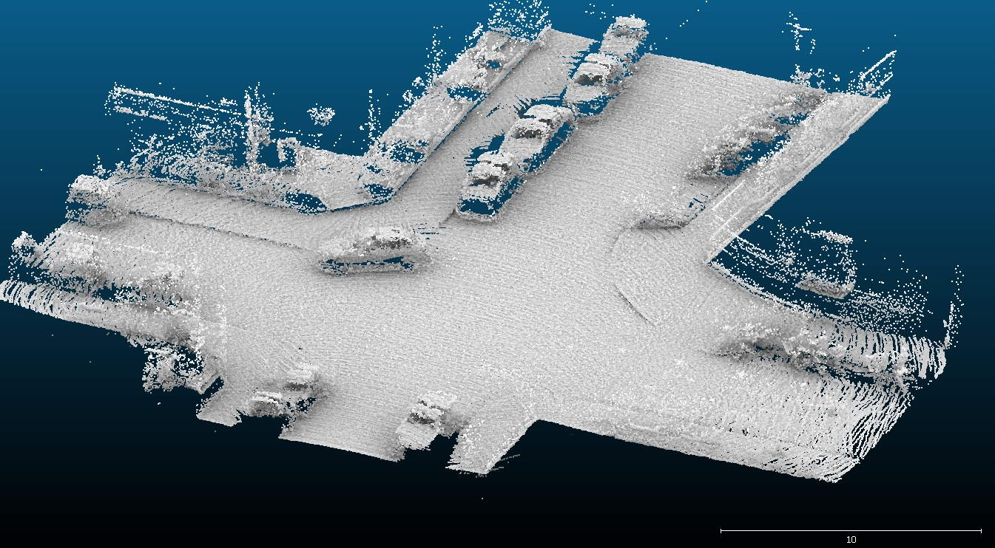
Introduction to Point clouds
Riegl reflectance
Riegl reflectance
Velodyn Laser, viewing reflectance
Ambient occlusion lighting with Cloud Compare on Velodyn points
Notes:
Top illustration are again colored based on intensity of return.
Bottom illustration are from a different lidar less precise, but acquiring much more points.
The bottom right illustration is only the geometry of the points (3D), with a lighting imitating ambient occlusion for better understanding of the scene.

Slide 8
Introduction to Point clouds
What are Point Clouds?
A set of unordered 3D points with attributes resulting from a sensing operation.
Unordered: don’t know who the neighbors are .
Attributes: ex: intensity of returning light, class id, angle …
Sensing: physical sensing of reality, not like a vector point representing the position of a tree (no semantic).
Mostly from :
Active sensors (laser time of flight based):
Terrestrial tripod
Terrestrial vehicle (cars/robot)
Aerial vehicle (plan/drone)
Passive/mixed : image (stereovision). RGBZ device (Kinect)
Notes:
It is important to understand three things:
- point clouds are a big pack of unordered 3D points.
- each point may have several attributes.
- points are result of sensing , they are measure.

Slide 9
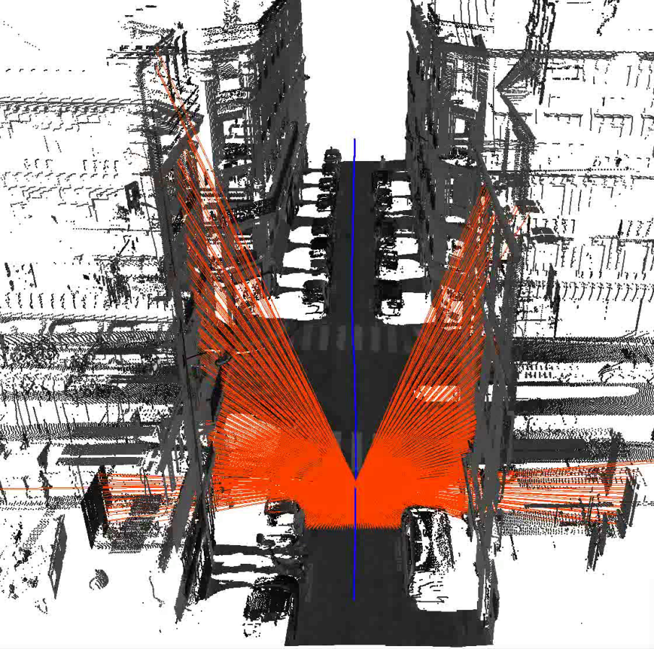
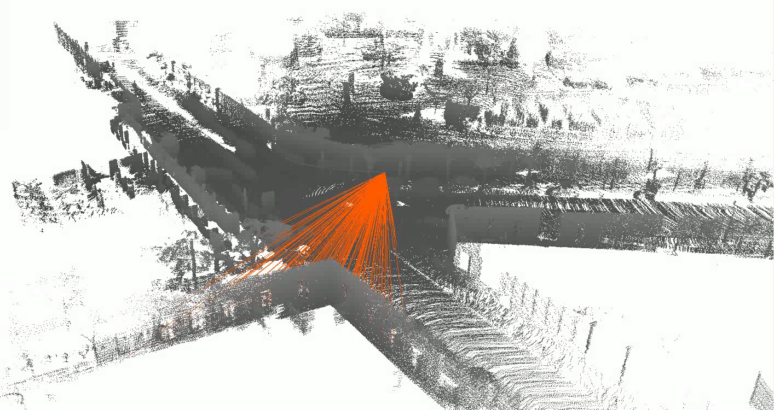
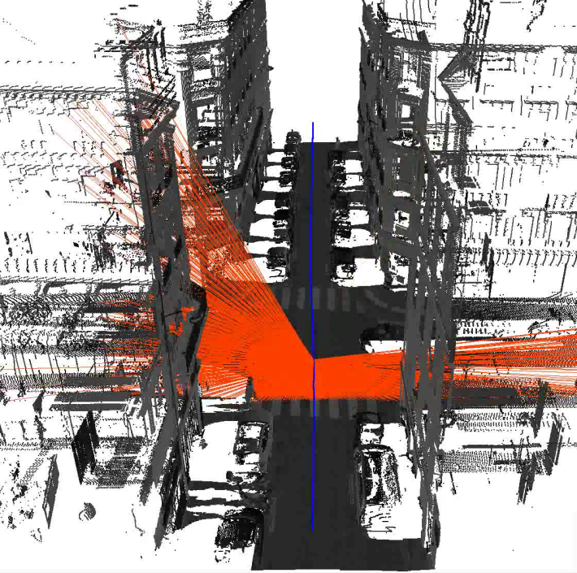
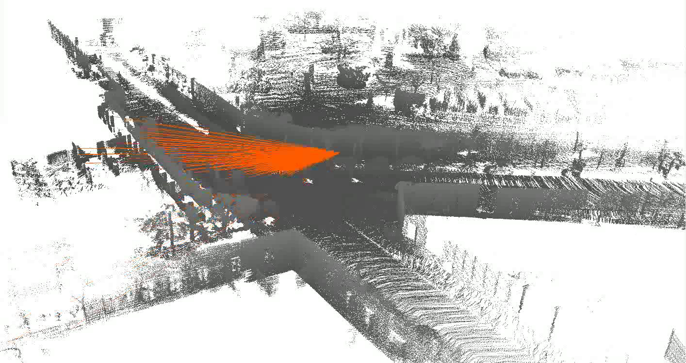
Introduction to Point clouds
Velodyn Laser
Riegl laser
Illustrations : F. Monier, IGN
Notes:
Left is an example of a Riegl lidar device:
When the vehicle moves forward along the blue line, it sweeps with laser around him in a plane orthogonal to direction.
This has several important consequences, like the presence of occlusion : if something stops the laser (like a car), we have no information for what is behind.
Right is an example of a Velodyn lidar device:
This laser is on top of a pole and rotating on himself.
It is like a lighthouse, but way faster.

Slide 10
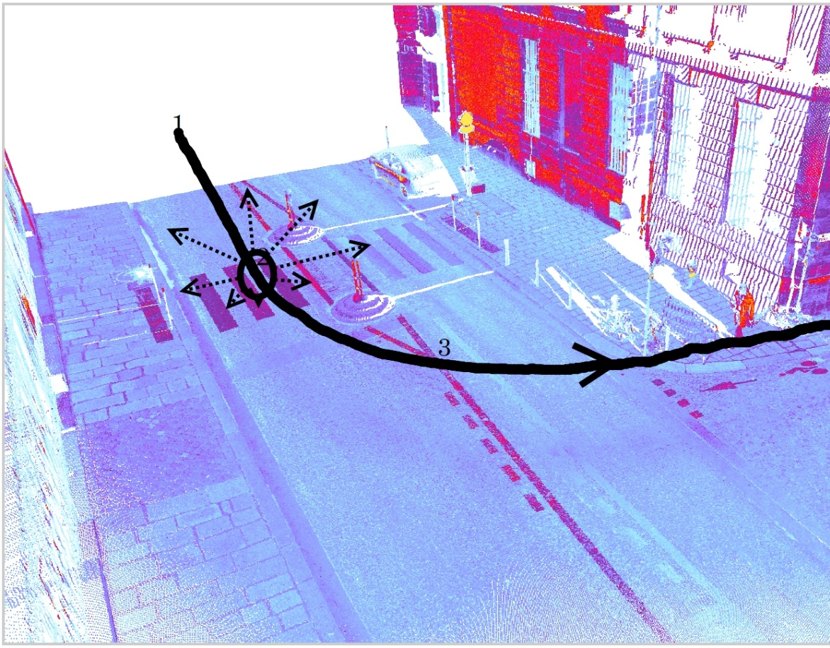
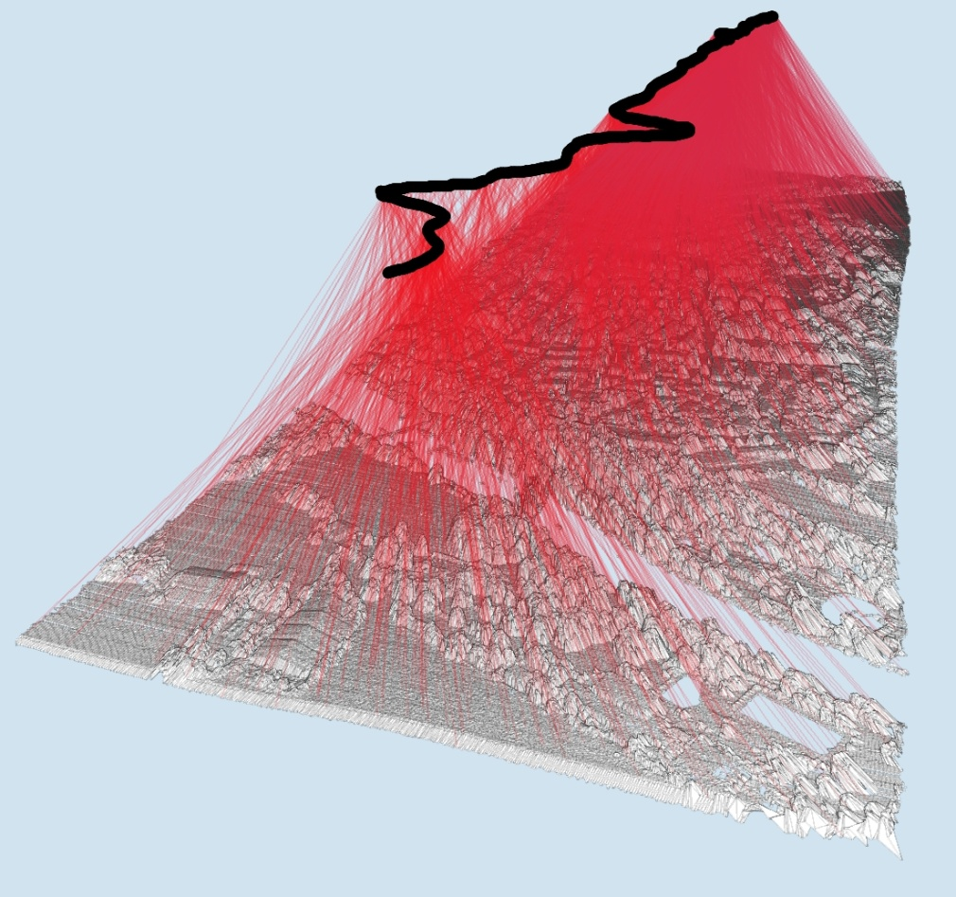
Introduction to Point clouds
Example : aerial and terrestrial point clouds
Non constant very high density
Almost constant low density
Image from J. Demantké Thesis, 2013
Image from J. Demantké Thesis, 2013
Notes:
The main differences between terrestrial lidar (left) and aerial lidar (right) are density of points, and geometrical complexity of scene.

Slide 11
Introduction to Point clouds
Why so many people use it?
3D from images is an ill posed problem. (i.e.: given a pixel in image space, what is its position and size in real world )
Very good precision (close and long range)
Reliable (night/day/shadows…)
Devices are affordable-ish (common on small robots, tested on small drones)
Complements very well images.
Notes:
We live in a 3D world, and 3D is often essential for fast understanding of something.
Yet, it is difficult to get 3D. One can draw it, reconstruct it from images, or get it from Lidar data.
Out of this 3 possibilities, only the lidar data can scale well _and_ be robust and precise.
Combining Lidar and images allows to benefit from the best of the 2 worlds: lidar can provide accurate geometry, image accurate radiometric information (i.e. colors).

Slide 12
Introduction to Point clouds
Order of magnitude
Point clouds are cool, but very BIG
Current devices: 1 Million points/sec, 12+ attributes. Ouch !
1 hour: several Billions points.
French mapping agency: 100’s of data sets, aerial + terrestrial, several type of lasers.
Can’t load much more than 20 Millions points in memory => can’t process much more than 10 Millions points at a time.
So much data: working on its own copy of it is not an option.
All data must be centralized on specific storage solution.
Notes:
Using point cloud one can easily step into the “big data” realm.
That is, when you have to use special strategies because using one computer won’t suffice.
Big data is not a showstopper per se, but has to be deal with using dedicated tools and methods.

Slide 13
Why use a Database Management System ?
What people do with point clouds?
Using A File system solution
Using A DBMS solution

Slide 14
Why use a DBMS?
What people do with point clouds?
(See [oosterom, 2014] in “resources”)
Create data
Query data based on localization time attributes
Mix data set
Convert data
Process data
Visualize data
Update data
Notes:
The requirement are very similar to other geospatial data:
Load the data, efficiently use it, process it, visualize it, write it.
The needs are a brief summary taken from (oosterom,2014)

Slide 15

Why use a DBMS?
Illustration of quad tree in file system
Typically, point clouds are cut in small files inside a hierarchy of folders (ex : quad tree).
Level folder cum_folder
Coverage
Folder
Folder
number
0 1 1
1 4 5
2 16 21
3 64 85
4 2.6e+02 3.4e+02
5 1e+03 1.4e+03
6 4.1e+03 5.5e+03
7 1.6e+04 2.2e+04
8 6.6e+04 8.7e+04
9 2.6e+05 3.5e+05
10 1e+06 1.4e+06
11 4.2e+06 5.6e+06
12 1.7e+07 2.2e+07
/s1
4⁰
/s1/s1..4
4¹
/s1/s1..4/s1..4
4²
Greater than max folder number on NTFS and EXT file system
Is it sufficient? 100k pts/file
8*10⁶ * 10⁵ = 10¹¹ = 800 Billions pts.
For one laser : 3.6 Billions/h.
Working day : 30 Billions
=> Only 30 days of work for 1 laser!
Notes:
This kind of quad tree solution is very common in problem where data can be easily partitioned.
The main problem is that such file system partitioning allows to use only one key for partitioning : either a spatial key as illustrated here, or an attribute key (for instance the precise moment of acquisition of a point).
This problem is similar to trying to order its personal photo collection : you can order it by themes (sport/vacation/…), __OR__ order it by date , but you can’t mix efficiently several orderings. To solve this problem one can use dedicated software that use a database engine.
Similar problem should lead to similar solution.

Slide 16
Why use a DBMS?
File system limitations
Create data
Get data based on localization time attributes
Mix data sets
Convert data
Process data
Visualize data
Update data
Only 1 user at a time
Need to choose a File structure adapted to one and only one query type (analogue to : how to sort personal photos)
Very difficult
OK
User need to create manually buffers of points
OK
Only 1 user at a time
Notes:
The most severe limitations are efficient query (localization, time, attributes, functions) and mixing data set.

Slide 17
Why use a DBMS?
Using a file system
Everything can be done, but it would amount to redeveloping a minimal DBMS system !
No security of the data
No concurrency
Need a different solution for every kind of geo-data (points, raster, vector)
Comparison to raster world:
Who use pure file system solution for data over 100’s of To?
Notes:
We use security in the broad sense: protection against errors for example.
In the G.I.S world data base have been common for dozen of year.
Incorporating a new spatial data (point cloud) with the other spatial data makes then lot’s of sense.

Slide 18
Why use a DBMS?
Using A DBMS solution
Allow concurrency / clusters of servers
All geospatial data in the same place
Efficient querying on localization & time & attributes & data set
Proper management of metadata at the data set level + relational link to other data.
Point clouds as a service : can be integrated in sophisticated client system (end of this presentation).
Why use Postgres and not a NoSQL database?
Parallel computing on multi cluster possible (postgres-xc)
Full ACID warranty
Can use python/R/C/Java
All geo data in same place.
Notes:
Without too much surprises using a DBMS solves problems that are hard to solve using file system solution.
The price is a DBMS is more complex to understand than a simpler solution.

Slide 19
PointCloud : an extension for efficient storing/querying/Loading in postgres
Storing point clouds in DBMS : Blue or Red pill?
What is PointCloud?
Efficient storage
FAST querying
FAST loading
Order of magnitude
Notes:
All this part uses PointCloud, a postgres extension written by P.Ramsey, the founder of PostGIS.

Slide 20
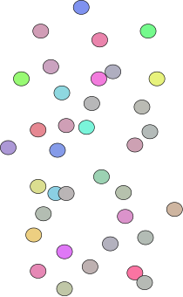
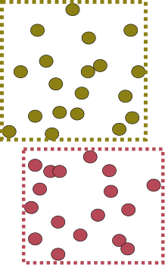
efficient storing/querying/Loading in postgres
Storing point clouds in DBMS : 2 approaches
1 point =
GPS_time (s) X (m) Y(m) Z(m) reflectance (…. )
54160.295 2068.230 20690.025 45.934 -9.4497
1 row = 1 point
Analogy : ST_Point
1 row = N points
Analogy : ST_MultiPoint
Billions of row -> manual partitioning
Billions of row -> big indexes
Double/float storage -> wasted storage
1 row = 1 point -> no compression
Different laser -> no compatibility
Different laser -> custom code everywhere
Millions of row -> 1 table per dataset
Millions of row -> small indexes
Custom bit width -> efficient storage
1 row = N point -> compress by redundancy
Different laser -> 1 family type
Different laser -> postgres extension
Usage : do we really need to get points 1 by 1?
Notes:
When storing billions of points in data base, we have to make a fundamental choice : do we store one point per row, or one group of point per row?
The only scalable and easy enough solution is to store a group of points per row.
This is the correct solution because we don’t usually want to get only one point, but more a group of points.

Slide 21
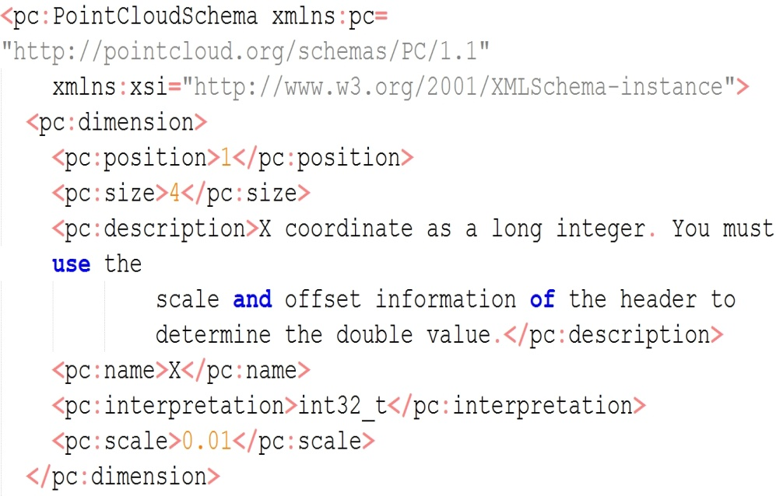
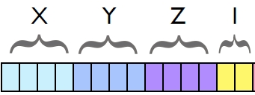
efficient storing/querying/Loading in postgres
What is PointCloud?
A Postgres extension created by P.Ramsey (founder of PostGIS) (see ref.).
Strong similarities to PostGIS (design, robustness, reliability, perfs) !
New types (PC_Point, PC_Patch) + cast to geom + functions
XML Schema
PC_PATCH(schema)
BBOX (PostGIS geometry)
Metadata , stats
PC_POINT(schema)
Illustration
from [Ramsey,2013]
Notes:
PointCloud is a really good base for point cloud in DBLS storage. It is very stable and reliable, and overall reasonably efficient.

Slide 22
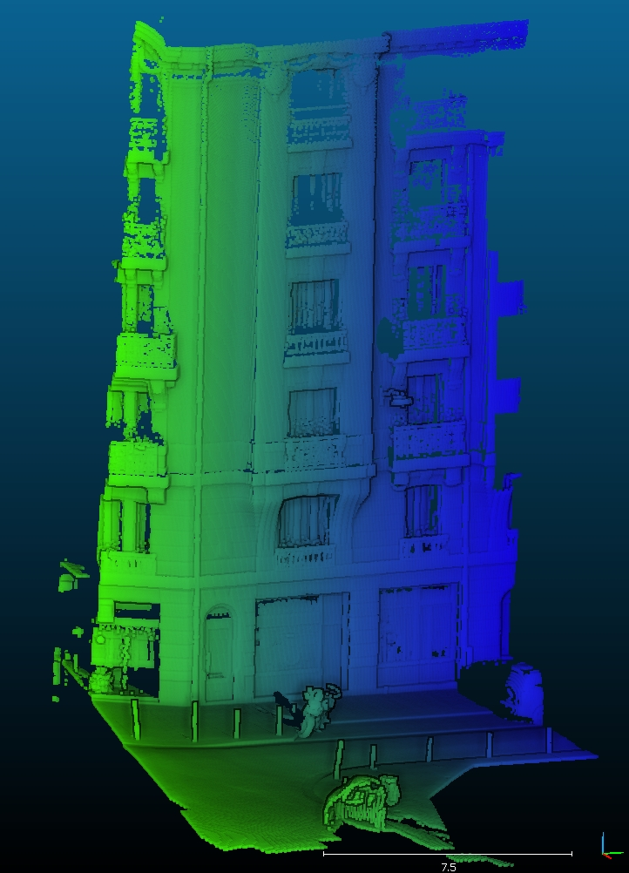
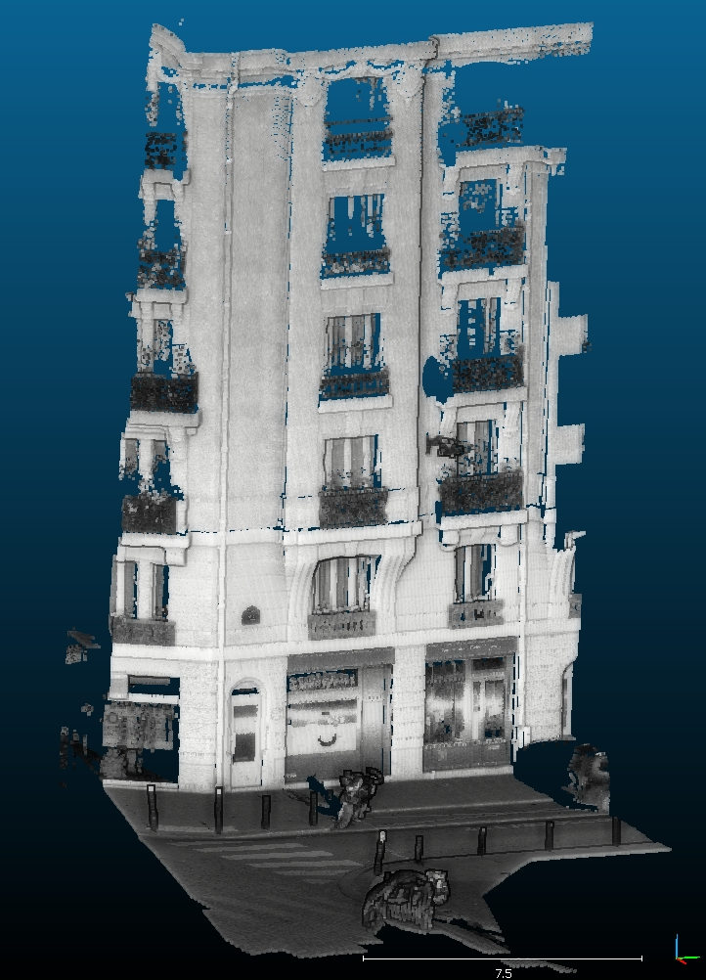
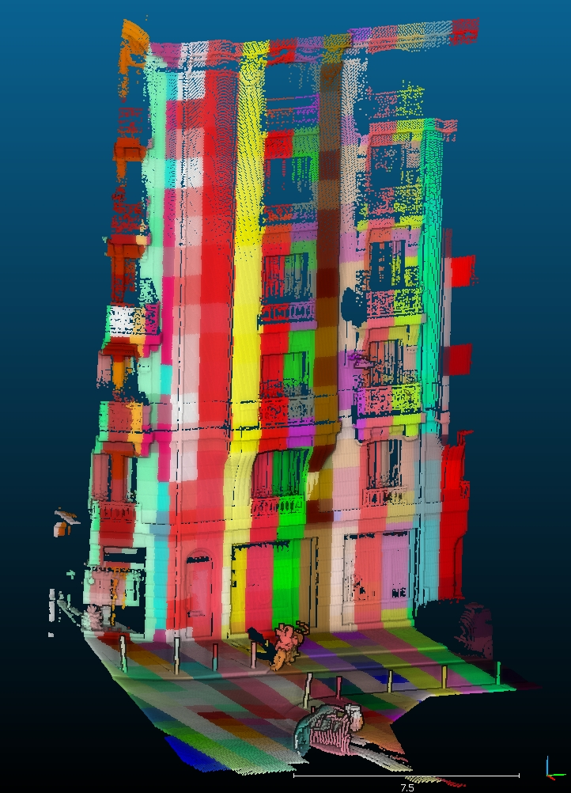
efficient storing/querying/Loading in postgres
Point cloud colored with time of acquisition
Point cloud colored with intensity of return
Point cloud colored with patch id
Notes:
Here are illustrations of a small piece of point cloud (about 1 million points), representing a façade and a small piece of Paris street
The left illustration shows the time of acquisition of each point with a green blue color gradient. (i.e. the vehicle was going left to right).
The middle illustration is colored with the intensity of return, along with special lighting to help understand.
The third illustration shows how the point cloud have been cut into patches.
In this case the patches are 1m3 wide.
In this case the number of points per patch varies a lot (10’s to 10k’s)

Slide 23



efficient storing/querying/Loading in postgres
Illustrations : Wikipedia JPEG
Efficient storage
Why compression is important?
An example form image world :
Full HD Camera : 1920×1080 pixels × 25images × (1+1+1 octet) /sec -> 155 Mbyte/s
Laser : 1 million points * 10 attributes * 2 (doubles) -> 20 Mbyte/s
Yet nobody is speaking of big data regarding video!
WHY?
Because we know very well how to compress images !
Example: standard for professional of video : DNxHD
Full HD : 18 Mbyte/s (1/8) or 4.5 Mbyte/s (1/30)
Notes:
Compression is fundamental.
The more important part of it is not really solving the practical problem of the data size.
It is more that a good compression exploits a structure inherent to the data. Thus compressing the data is more about understanding the data.

Slide 24
efficient storing/querying/Loading in postgres
Efficient storage
PointCloud can compress patches.
Compression is always about exploiting similarities.
PointCloud work attribute by attribute for one patch
Depending of the similarities, 3 methods are proposed
Use bit mask : 10001 ; 10002; 10003 -> mask=1000, data = 1,2,3
Use repetition: 10,10,10,10,10,10,10 -> repetition=6, data = 10
Use lzip deflate algorithm (dictionary, tree)
Example :
For this benchmark data , 12 Million points,
On disk : binary file on disk 600 Mbyte
zipped Binary file on disk : 305Mbyte
In base : 25 k patches, (Table=10)+(toast=290)+(index=5) =305 Mbyte
Notes:
In general, the strategies used to compress point clouds are much less sophisticated than those used in image world.
For instance the sophistication of the JPEG2000 standard.

Slide 25
efficient storing/querying/Loading in postgres
FAST SPATIAL querying
We index patches as polygons.
CREATE INDEX ON patch USING GIST(patch::geometry)
Index in several S.R.S possible
CREATE INDEX ON patch USING GIST(ST_Transform(patch::geometry,4326)::)
FAST Attribute querying
Example : precise time of acquisition
Use a function that compute range of an attribute in a patch rc_compute_range_for_a_patch( patch, text) : NUMRANGE(PC_PatchMin(patch, ‘GPS_Time’),PC_PatchMax(patch, ‘GPS_Time’),'[]');
GIST Index on this function CREATE INDEX ON patch USING GIST(rc_compute_range_for_a_patch(patch,’GPS_Time’)
Notes:
It is important to understand that with _one line of code_
, we deploy a powerful Rectangle-Tree on the data, as well as automatic stats on the data to help decide if it is worth it to use R Tree or not.
The simplicity of index usage allows to use several on different keys.
This indexes are automatically combined if we query using multi criteria.
There are several type of indexes , and several options to best use them. This is out of scope of this presentation.
Bottom line is : index creation is easy, and index are very effective.

Slide 26
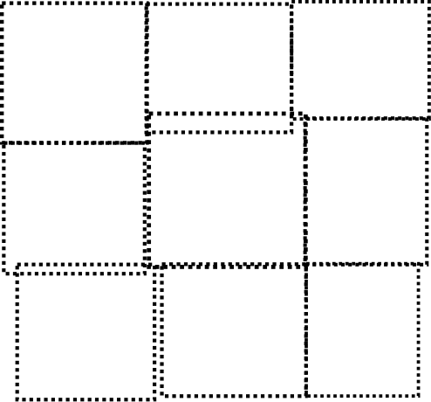
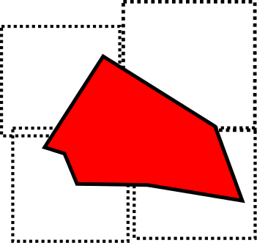
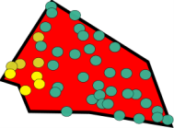
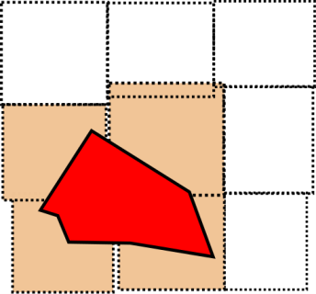
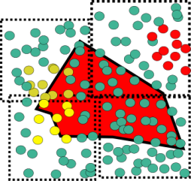
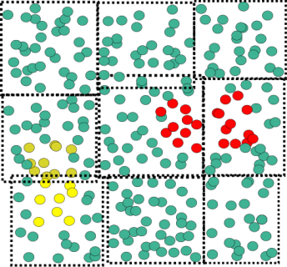

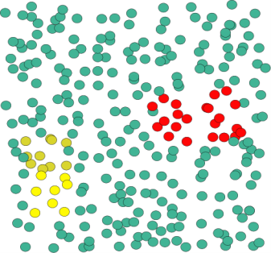
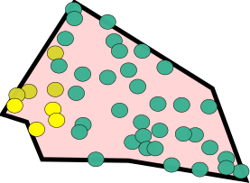
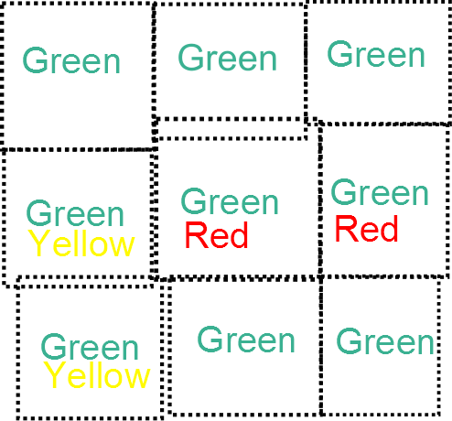
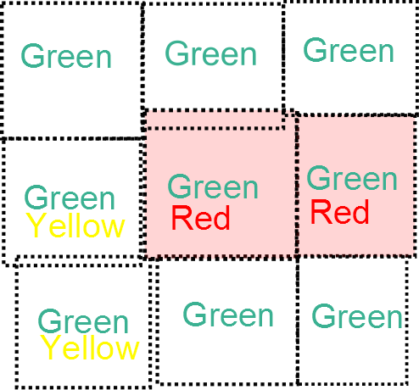
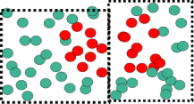
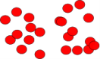
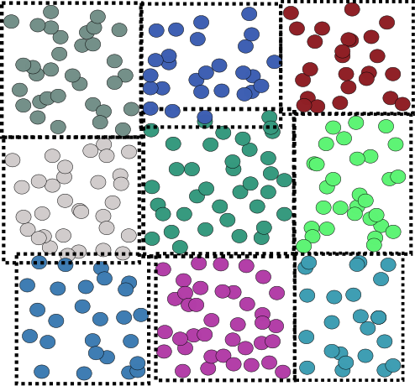
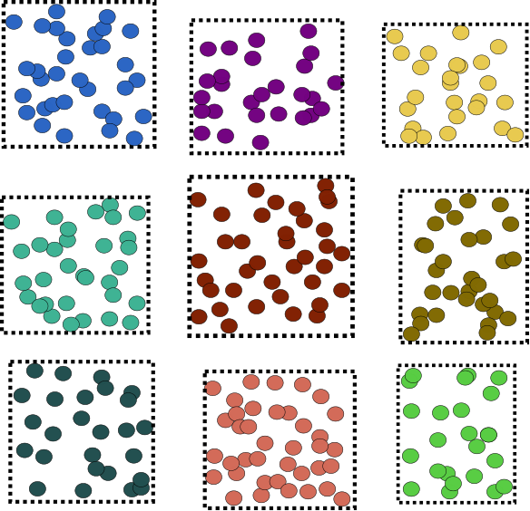
efficient storing/querying/Loading in postgres
?
FAST SPATIAL querying
Points inside: ?
?
Red points?
FAST Attribute querying
Notes:
The top part illustrate an efficient spatial query (ex. 1 ms, on the 5 Billion points database, 500k patches). The bottom part shows an efficient attribute query. (same)
This attribute query is simplified for the illustration purpose, but in fact we can query on range.
For instance let’s say that every point has a number between 0 and 1 representing the intensity. We can efficiently answer to the question ; “what points have grey value between 0.34 and 0.59?”.

Slide 27
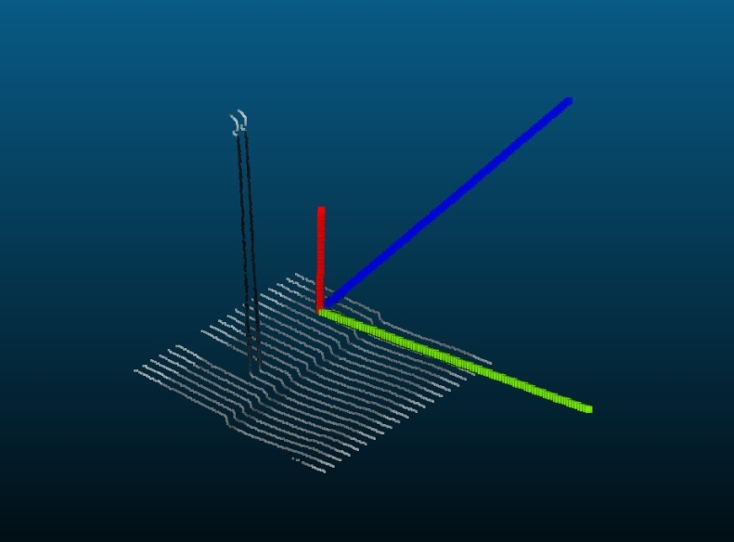
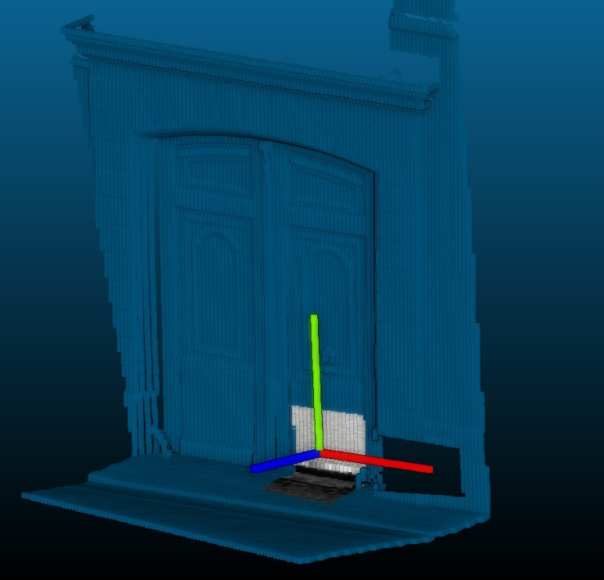
efficient storing/querying/Loading in postgres
BONUS : postgres super-cool feature :
FAST Function query : index on ND Descriptor
Example :
Define a function computing ND descriptors of the patch
example : How vertical is the patch? (based on ICA)
Create an index on it
Verticality descriptor for a patch half façade half ground
Verticality descriptor for a patch containing a pole
(0.1 ,0.002,0.008)
(0.7 ,0.001,0.005)
Notes:
Postgres has a very powerful functionality that is _index over function_ . We can leverage this in point cloud server.
The point cloud is stored as a set of patches, each patch containing some points.
We can compute one or several descriptor for every patch. Then we can use these descriptors to query even more efficiently. For instance, the illustrations shows a verticality descriptor.
When looking for points describing a street markings for instance, one can use the verticality descriptor to exclude all patches on façades.

Slide 28
efficient storing/querying/Loading in postgres
FAST Loading in PointCloud
For Simple test : use PDAL (GDAL for point clouds wannabe)
An example of fast loading: project PointCloud_in_db (PROTOTYPE)
Parallel loading into a server : we can load as fast as we acquire data !
Prototype. Bash + SQL
Patch table:
Id, PC_Patch(n)
Binary Point cloud files
(ply)
Linux Pipe
Temp table
X,Y,Z,I,…
Create patch
(GROUP BY )
Space + time
Write patch
Indexes
Convert to ASCII CSV
Psql+ COPY
Notes:
The schema is simplified.
In fact PointCloud_in_db is a prototype and could be easily made several times faster. (for instance, reading directly data in binary file, instead of casting it to ascii, then parsing the ascii…).
The point is to prove that efficient loading is possible

Slide 29
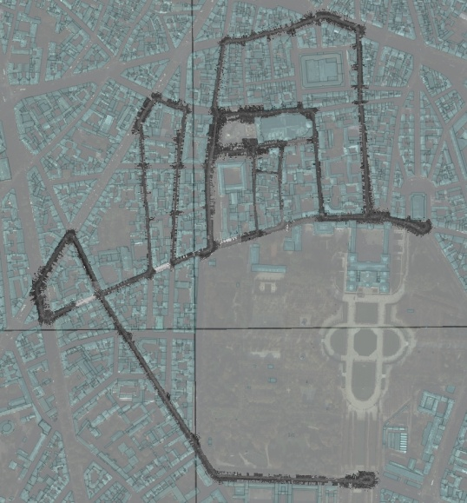
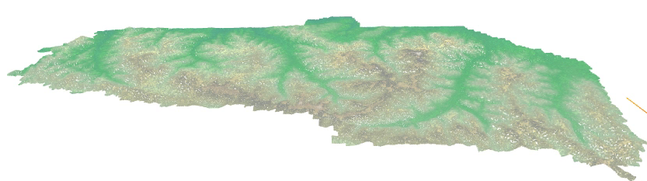
efficient storing/querying/Loading in postgres
Paris terrestrial acquisition 2013
Above view
Order of magnitude
Tested on
T: terrestrial , 600 Millions, 22 Attributes . 12km of streets in Paris
2.1 Million rows
Table : 1.4 GByte | Toast : 29 Gbyte | indexes : 500 MBytes
Big variation in Density/patch
A : aerial, 5.2 Billions , 9 Attributes. 1300 km2 in Vosges, France
580k rows
Table : 64MByte | Toast : 45 Mbyte | indexes : 85 MBytes
Density almost constant.
Vosges aerial acquisition, 3D render
Querying is fast! (1-2ms)
ASCII output : 100k pts/sec
Notes:
The left illustration is the Vosges dataset.
The second illustration is an overview of the Paris 6 data set.

Slide 30
In base processing
In Base processing : what is so cool about postgres?
PL/R : clustering
PL/PYTHON : clustering
PL/Python : plan detection
Pl/pgsql : patch->raster
PL/Python : image processing : detection
Notes:
The previous parts shows basics for a point cloud server :
- efficiently loading data.
- efficiently getting points based on several criteria.
We can use these to do in-base processing.
The classical workflow would be to getting data, processing, then writing result on database.
Instead, when doing in-base processing, the processing is directly done inside the point cloud server.
This avoid unnecessary data transfer.

Slide 31
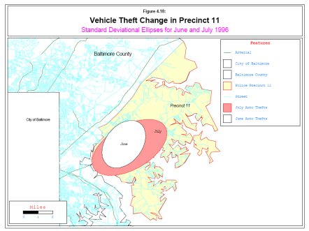
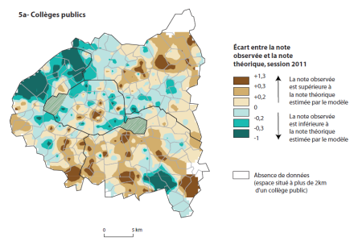
In base processing
In Base processing : what is so cool about postgres?
Very easy and fast for prototyping :
C , C++
High level languages :
R
Very advanced stats
Advanced Fitting/patterns/clustering capabilities
Many geo modules (sp …)
Possibility of GUI in browser (shiny)
Python
Powerful script language
Powerful Object Oriented language
Fully integrated in most GIS (ArcGIS, GRASS, QGIS))
Can link to C/Cpp for perf (Cython)
Java
Less integrated in postgres
Illustrations from [Cura,2014]
Easy to learn/use
IO to DBMS + GIS world.
Central Repo
Fully portable
Well established
Notes:
Postgres offers the possibility to use many language directly in base . Among these languages 2 are particularly useful for fast and powerful prototyping : R and Python.
In this presentation we demonstrate basic usage of both.

Slide 32
In base processing
In Base processing : what is so cool about postgres?
Easy to create an extension
High level languages
C , C++
Very efficient (memory/CPU)
Integrating into Postgres forces common meta API/data
This allows re-use / complex processing pipeline.
C world
SQL world
C++
/ C
lib
C API
Postgres
C
wrapper
Postgres
plpgsql
wrapper
SQL query
Notes:
When prototyping is done, it is really easy to add a postgres C/C++ extension to have a better efficiency.
An important point of in base processing is that is forces de facto a common framework/API.
Thus is guarantee inter-operability, which maximize re-use and allow to easy form complex processing pipeline.

Slide 33
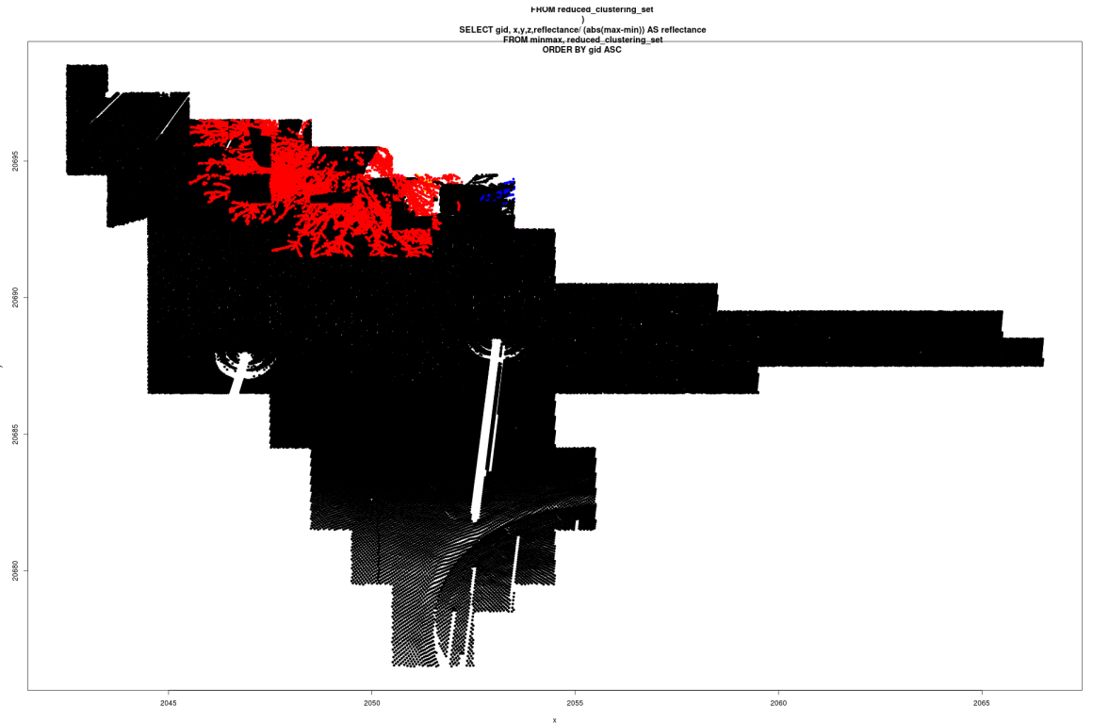
In base processing
PL/R clustering (proof of concept)
Unsupervised clustering.
Input = 3D points, module= nnclust , method = minimum spanning tree
Result : points in tree are separated from points on road
R classification, viewed from above. Color = classes
Notes:
We demonstrate in-base R processing, using the nnclust R package to try to cluster points of a point cloud.
The illustration (viewed from above) shows that the R function has put different labels on points in tree and points on road.

Slide 34
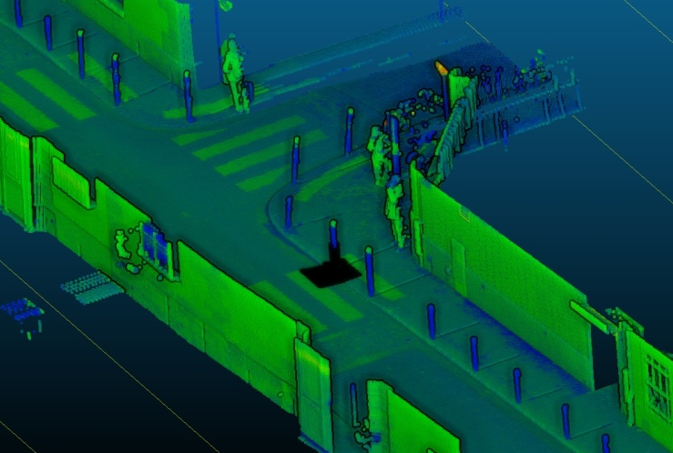

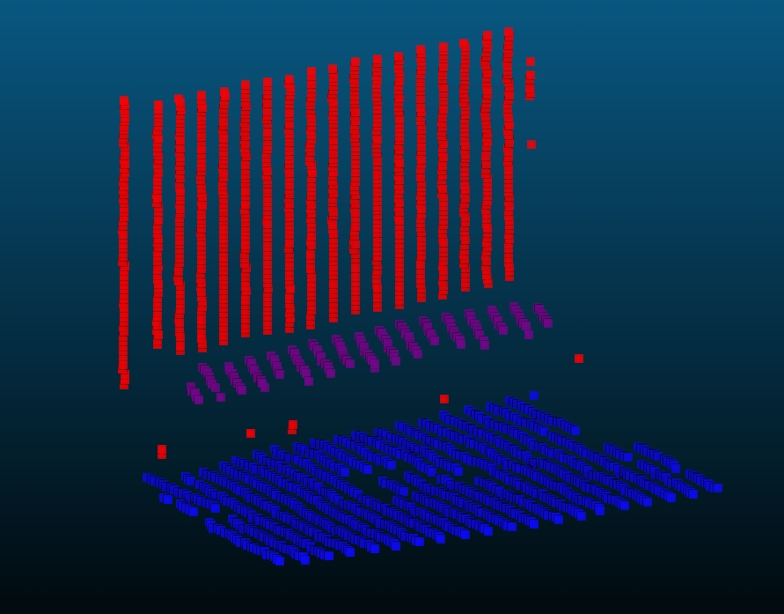
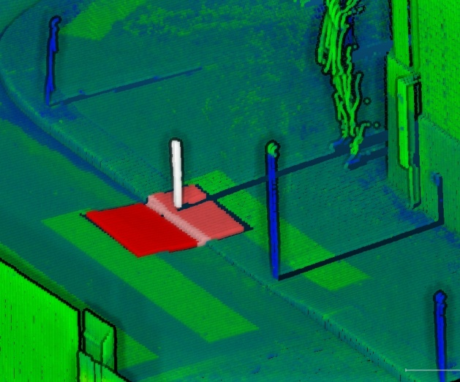
In base processing
PL/PYTHON Plan detection (PROOF OF CONCEPT)
For list of points (double[ ])
Convert list to numpy array
Convert numpy array to python-pcl point cloud
Until no more plan is found
Find a plan using p-Ransac
Remove points of the plan from the cloud
Context : 3D + reflectance
Context : 3D + lighting
1 color per plan found
1 color per plan found white to red
Notes:
This example using pl/python shows how to detect plan in a patch using python-pcl.
The bottom middle and right illustrations use a color per plan detected (following orientation of normal) to get an idea of the result.
The important point is points have been correctly classified into plans.
Detecting plans is vital because they are high level geometric primitive.
For instance instead of storing 1k points on a plan, we can just store the equation of the plan and it’s limits.
Using such geometric primitive will then allow to do very fast proximity and intersection test, and gives info about what the points may be ( _not_ a tree for instance).

Slide 35
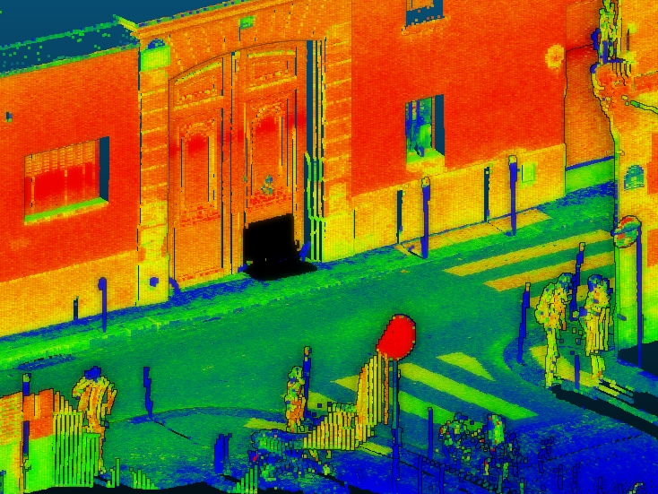
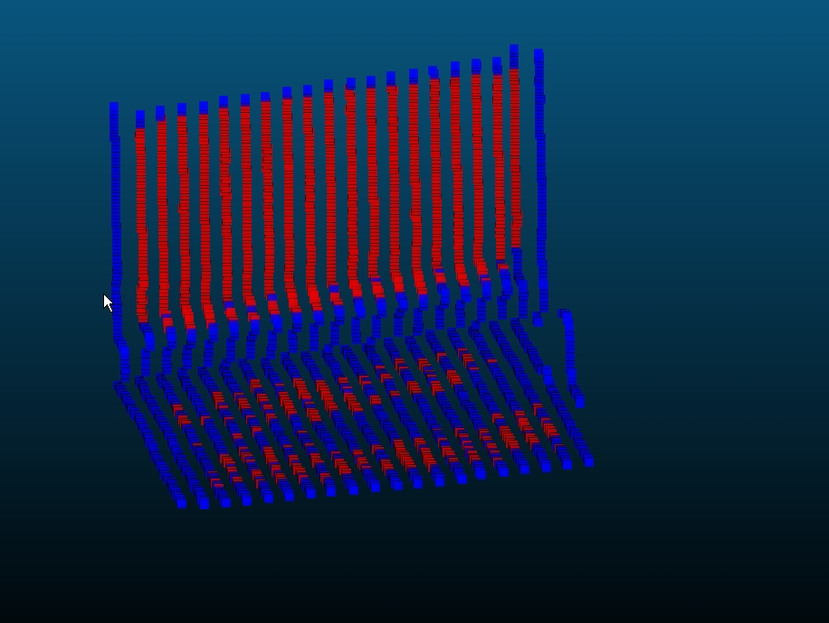
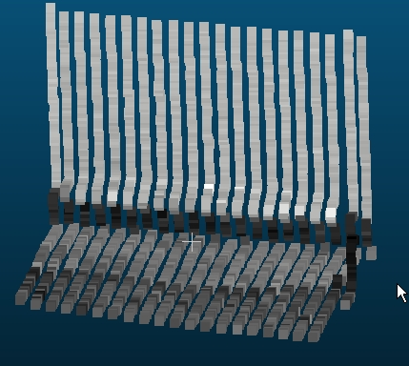
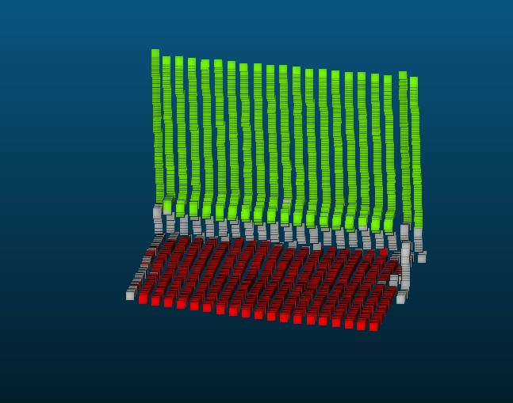
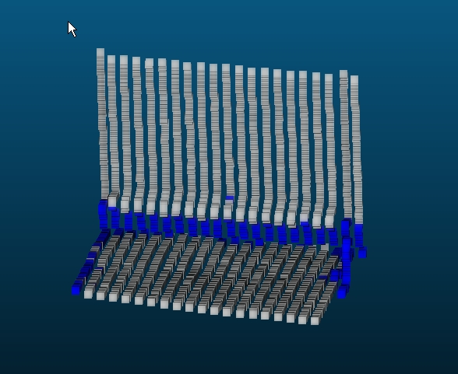
In base processing
PL/PYTHON unsupervised CLUSTERING (PROOF OF CONCEPT)
For list of points + reflectance (double[ ])
Convert list to numpy array
(Compute normals using python-pcl)
Cluster using sklearn.cluster.DBSCAN
Join clustering label to point id
context
3D + reflectance
labels
outliers
core
Notes:
Here a pl/python proof of concept use a totally different method to try to group points into meaningful groups (unsupervised clustering).
In opposite to the most common situation, the method doesn’t know what to look for or how many objects it must find.
The DBSCAN implementation used here scales very badly (compute distances between every points), but is sufficient to exhibit interesting results.
A byproduct of the method is a new label saying if the point is very meaningful to its group or not. This could be used to robustify the process.

Slide 36



In base processing
Notes:
The result on a larger area are much more interesting.
The method has automatically separated the points into objects.
These objects are quite close to ones a human would have chosen.
Yet some objects have not been segmented (a zebra is missing for instance)

Slide 37


In base processing
PL/PYTHON descriptor (PROOF OF CONCEPT)
For list of points (double[ ])
Convert list to numpy array
Get Principal direction using sklearn.decomposition.FastICA
(Project result on Z)
Output measure
Idea : descriptor at patch level of verticality : is this patch façade/road/ tree/ mixed? => allow filtering at patch level
Notes:
We presented 3 clustering methods using PL/R or PL/Python. Such processing is done in-base but could be done outside of the db. In the application presented here the ability to use it in-base is essential.
The idea is for instance to add a column to the patch table called descriptor. So for every patch of points, we have a descriptor.
Such descriptor is very useful to filter the patch, or try to guess what the points in a patch represent.
The capacity to compute the descriptor in base allows for automatic update of the descriptor whenever the points in a patch changes or when a new patch is added (via triggers).
This guarantee that the descriptor is up to date with the patch.

Slide 38


In base processing
pL/PGSQL Patch->raster (proof of concept)
For a patch
Get Bbox
Round X Y to pixel size
Group by X,Y rounded
For each attributes
Add a band
File the band with Mean/max/min of attribute for computed pixels
Very slow (0.1 to 1 sec/patch !)
Concept : raster+points. Color = reflectance. Qgis
A street part viewed in QGIS trough GDAL PostGIS raster driver
Notes:
This example shows the use of another script language : pl/pgsql. This language is interesting because it is very tightly integrated into postgres and interacts very well with SQL.
This proof of concept function convert a point cloud into a raster (image viewed from above).
It is formally a projection parallel to the Z axis of points, then a quantization to form pixel of the given size.
It is essential to be able to convert point clouds to image because image processing algorithm can be greatly accelerated using GPU.
Moreover, in the image dimension we can leverage the neighborhood information (we know close pixels) that is missing in point cloud.

Slide 39



In base processing
PL/PYTHON image processing (PROOF OF CONCEPT)
Convert set of patches to raster (projection on Z of the points, rasterisation)
Accum. raster. Lot’s of “NoData”
reflectance
Relative height
Notes:
We now use the conversion from patches to raster to perform python image processing on a point cloud.

Slide 40




In base processing
PL/PYTHON façade detection (PROOF OF CONCEPT)
For a raster (accum) from a point cloud projected
Keep pixel high enough (higher than acquisition vehicle)
Remove pixel close to no data
Threshold on number of accumulated point per pixel
Morphological closing
Straight skeleton
Hough lines detection
Result with ground truth
Notes:
The first application is to detect borders of buildings.
We convert the point cloud to raster, then use various filters to detect border of building in it.
The right illustration shows the result, that are very close to the ground truth (Open Data Paris Building data).
The small variation may be explained by the un-precise way we define building border : are we taking into account balcony, flap, etc.?
The detection is based on geometrical information.

Slide 41



In base processing
PL/PYTHON Sidewalk detection (PROOF OF CONCEPT)
For a raster (height) from a point cloud projected
Keep pixel low enough (at vehicle wheels)
Remove pixel close to no data
Compute gradient of height (height variation)
Filter gradient to keep sidewalk (0.1 to 15 cm)
Result (orange to red) with ground truth (blue)
Reflectance at wheel level
Gradient at wheel level
Notes:
Another image processing with pl/python allows to detect sidewalk (and gutters).
Such information is very important because it structures strongly the street space.
The detection is based on geometrical information.

Slide 42






In base processing
PL/PYTHON Markings detection (PROOF OF CONCEPT)
For a raster (reflectance,height) of a point cloud projected
Compute height gradient
Remove pixels near NoData and/or non flat
Smooth reflectance while preserving edges (bilateral filter)
Compute reflectance gradient, threshold
Detect lines (Probabilistic Hough )
Compute center and angle of lines
Cluster lines using DBSCAN
Line clustering
Line detection
Raster reflectance
smoothing
gradient
threshold
Notes:
We demonstrate a more complex image processing pipeline to detect street markings. This example also use geometrical information as well as reflectance information (intensity of returned laser impulse).

Slide 43






In base processing
PL/PYTHON Markings detection (PROOF OF CONCEPT)
Line clustering
threshold
Raster reflectance
gradient
Line detection
mask
Notes:
Same method illustrated on a bigger area.

Slide 44
using the point cloud server in complex architectures
Batch processing
Visualization : Level Of Detail
point cloud streaming
Point cloud as a service
Notes:
We presented some processing methods that take place in the DBMS.
Yet some very intense processing may better be done outside of the server, on a different computer.
For this purpose the point cloud server can be used in 2 different ways :
- To generate on the fly point cloud files for traditional programs
- To stream points for adapted programs.
The last usage allows the construction of complex architecture.

Slide 45


using the point cloud server in complex architectures
Batch processing:
How to launch (parallel) processing on overlapping areas?
Using file system : manual buffer. Need to load lot’s of files (x9 )
Crude grid pattern. Custom for every use case.
Difficult to use trajectory
One file processing
Following file processing
Notes:
When processing big point clouds, a common problem is to process small pieces of the point cloud at a time.
The difficulty is that it may be necessary to have overlapping processing area to guarantee that points on the border are correctly handled.
If the point cloud is stored in a file system, this has to be done manually, is very limited and is inefficient.
The illustrations shows an example of processing a single file. All nearby files must also be loaded. So to process one file we must load 9 files !

Slide 46




using the point cloud server in complex architectures
Overlapping surfaces 1
Batch processing:
Using point cloud server , but process see files
Exact control of overlapping/surfaces ( x1.5 )
Clean Loop management
Trajectory + buildings
Overlapping surfaces 2
Point cloud server
Use trajectory to generate overlapping surfaces
Trajectory data
patch
Temp point cloud for an area
Out of DB processing
Notes:
When doing batch processing with a point cloud server, it is easy to leverage other information already stored in the DBMS, like the trajectory of the acquisition.
This way, we can precisely control how much overlap we need, and create on the fly temporary point cloud files on the disk for the out of db processing.
Illustrations shows how a trajectory has been automatically cut into overlapping surfaces. Then the processing is done surface by surface, each time writing on disk all the points in a surface.

Slide 47



using the point cloud server in complex architectures
Visualization : Level Of Detail
no need for all the points all the time!
Max 1 point per pixel : 2 Millions for Full HD (+ cache + anticipating) If the patch is far away, need only few points
D. Vandergucht, IGN, 2014
5.2 Billions points !
We need a way to generate pyramidal resolution for a patch!
Notes:
A big challenge with point cloud data is visualization.
Visualization is essential to understand data.
Yet printing 5 billion points on screen is not an option.
Instead we need to adapt the number of point we print depending of the distance of the patch. If the patch is very big on screen, it needs to be detailed. If the patch takes only one pixel on screen, it needs only 1 point.
Thus we need visually acceptable method to make the number of points per patch vary.

Slide 48



using the point cloud server in complex architectures
Visualization : Level Of Detail for Patch (PROOF OF CONCEPT)
Full pl/pgsql
Idea : no duplication :
Simply write point in a given order
The more we read, the more we get LODs
LOD0 then LOD1 then LOD2 … then the rest
What order?
For each level N:
2^{N} points closer to center of level N of a Quad tree
Order in each level : random or inversed Z order curve.
Notes:
We present a way to solve the problem of multi-resolution patch without duplicates of data.
The idea is simply to write the points of a patch in a determined order.
Then, reading more or less points from the beginning of the patch will make a patch more or less resolute.
Right illustrations show a point cloud, where the size of the point is proportional to its ordering.
We can see that if we take the point starting from the bigger and going toward the smaller, we always have a good approximation of the total point cloud.
The more we go toward the smaller points, the more detailed is the patch.

Slide 49





using the point cloud server in complex architectures
Visualization : Level Of Detail
…
Notes:
Here is an example on real data (some level are skipped).
There is no duplication of data, only reordering.

Slide 50

using the point cloud server in complex architectures
Asynchronous point cloud streaming to browser (Prototype)
2. Get patches, extract points
(LOD)
Point cloud
Server
C , SQL
Node.JS
Server
JavaScript
4. Parse
Put in WebGL memory
Render on screen
3.(compress)Here are points
Illustration Q. Nguyen, IGN, 2014
Viewer
(Browser)
Client
WebGL, JavaScript
1. Give me points in this area. POLYGON(…)
Concept schema : Q. Nguyen, IGN, 2014
Notes:
We can use the point cloud server to asynchronously stream 3D points to a browser.
In this prototype, the browser is set at a location. It will then asks the point cloud server all the points that are around this location (level of detail and complex spatial query are possible).
The point cloud server will find extremely fast which patch is close to the location, and send the corresponding points.
These points are then rendered on the browser screen using WebGL.
Using a node server allows the a-synchronicity : the browser is not blocked when loading points, it is a background task.
Schema has been greatly simplified.

Slide 51





using the point cloud server in complex architectures
Asynchronous point cloud streaming to browser (Prototype)
Illustration Q. Nguyen, IGN, 2014
Notes:
Illustrations reading left to right top to bottom of the points being streamed to the browser.
The camera point of view change because the user can explore the data, and does not have to wait for all the data to be loaded.

Slide 52

using the point cloud server in complex architectures
Interactive 3D Sidewalk reconstruction (Prototype)
8. Get patches, extract points
(LOD)
Point cloud
Server
C , SQL
11. Write result in tables
7. Give me points in this area.
9. Here are points
Web Processing Services
(Zoo Project)
Illustration A.Hervieu, IGN, 2014
5. User select points on screen
10. Process points
Viewer
(Browser)
Client
WebGL, JavaScript
6. Here are the points/parameters. Launch WPS
Concept schema : Q. Nguyen, IGN, 2014
Notes:
We present an even more complex architecture where the point cloud server is used to stream points to browser for visualization, as well as to stream points to a web processing service.
The web processing service is a method to semi-automatically reconstruct road surface and sidewalk surface.
The method starts by selecting a few points on the border of sidewalk. Then the method moves forward and try to find sidewalk again.
In fact the interaction is more complex, and the user can stop/start/redirect the method interactively.
Please note that we omitted the previous part of the schema for more clarity.

Slide 53






using the point cloud server in complex architectures
Interactive 3D Sidewalk reconstruction (Prototype)
Illustration A.Hervieu, IGN, 2014
Notes:
Illustration reading left to right top to bottom.
Illustrations 1 and 2: the user select starting point on the curbstone to initialize the algorithm.
Illustrations 3 and 4: the method model road and sidewalk surfaces, and moves forward.
Illustrations 5 and 6: result : road and sidewalk modeled.

Slide 54
Conclusion

Slide 55
Conclusion
Point cloud server with postgres/PostGIS/PointCloud
Very powerful.
No need to be Linus Torvalds to get results.
It’s only the beginning.
Many things to improve

Slide 56
Conclusion
Some example of Things to improve in PointCloud
I/O perf
Conversion to/from raster
Conversion to/from meshes
Get only some attributes of points in a patch
Get only some points in a patch
Use BLOB to store patches (allows efficient streaming, avoid Toast)
Integrate PCL
3D bbox, oriented 3D bbox.
…

Slide 57
ressources
Documentation
Tools

Slide 58
Doc
[Demantké, 2014] J. Demantké, 2014: Thesis
[Ramsey,2013] P. Ramsey presentation of PointCloud : boundlessgeo.com/wp-content/uploads/2013/10/pgpointcloud-foss4-2013.pdf
[Oosterom, 2014] : Point cloud data management P. van Oosterom, S. Ravada, M. Horhammer, O. Marinez Rubi, M. Ivanova, M. Kodde and T. Tijssen IQmulus Workshop on Processing Large Geospatial Data, 8 July 2014, Cardiff, Wales, UK
[Cura,2014] R: a free software for statistical analysis Introduction to the analysis of geographical data with R; 2014 ; R. Cura, H. Mathian
All terrestrial point clouds are from Stereopolis, IGN.

Slide 59
TOOLS
Postgres / PostGIS
PointCloud
CloudCompare
RPly
PDAL
GDAL
QGIS
Pl/python : python-pcl, scikit-learn, python gdal, numpy, scipy
Pl/R : NNClust

